Slide 1
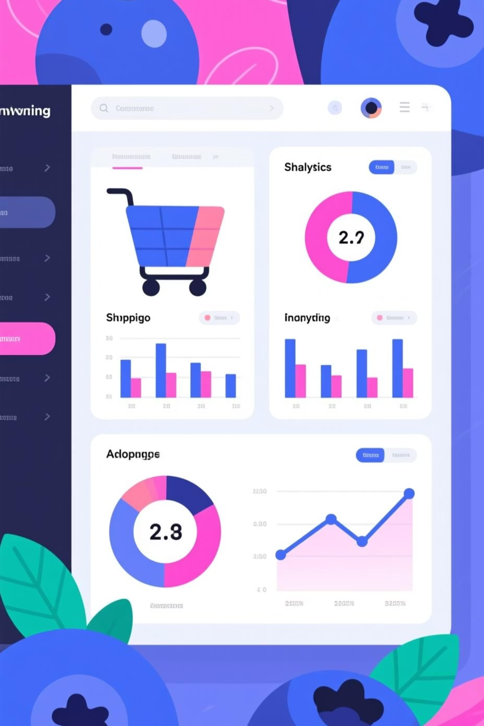
Customer Shopping Behavior Analysis
Uncovering insights from 3,900 customer transactions to drive strategic business decisions through data-driven analysis of spending patterns, customer segments, and product preferences.

Slide 2

Dataset Overview
3,900
18
$59.76
3.75
Total Purchases
Data Features
Average Purchase
Average Rating
Transactions analyzed across all product categories
Comprehensive attributes tracked per transaction
Mean transaction value across all customers
Customer satisfaction score out of 5.0
The dataset captures customer demographics, purchase details, shopping behaviors, and product preferences. Key features include age, gender, location, subscription status, item categories, purchase amounts, discount usage, and review ratings. Only 37 missing values were found in the Review Rating column.

Slide 3

Data Preparation & Cleaning
Python Analysis Steps
Key Statistical Insights
We began with comprehensive data preparation using Python to ensure data quality and consistency:
Distribution analysis revealed important patterns:
Age Distribution: Shapiro-Wilk test showed non-normal distribution, indicating concentration in specific age ranges
Imported dataset using pandas for analysis
Explored structure with .info() and .describe() methods
Imputed missing Review Rating values using median by category
Purchase Amounts: Uneven spending patterns with small group contributing disproportionately higher amounts
Standardized column names to snake_case format
Created age_group feature for segmentation
Database Integration: Connected to PostgreSQL for advanced SQL analysis

Slide 4
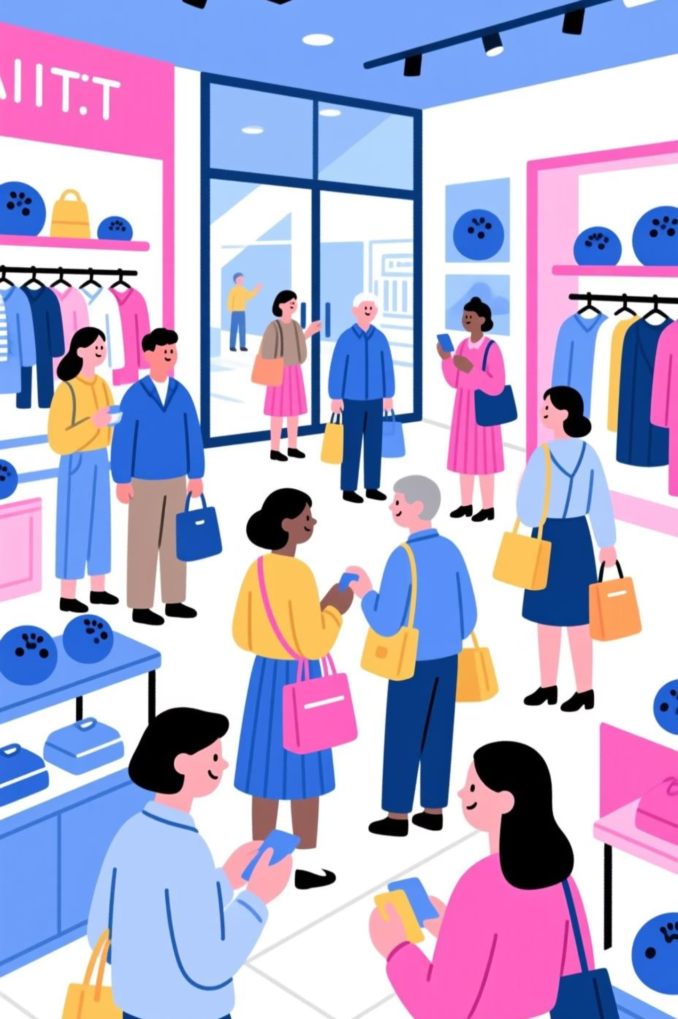
Revenue Analysis by Gender
Male Customers
Total Revenue: $157,890
Average Spend: $59.54
Males represent the larger customer base and contribute significantly more to total revenue.
Female Customers
Total Revenue: $75,191
Average Spend: $60.25
Females show slightly higher average spending per transaction despite lower total volume.
While male customers drive higher total revenue, female customers demonstrate marginally higher per-transaction spending. This suggests opportunities for targeted marketing to increase female customer acquisition while maintaining male customer engagement.

Slide 5
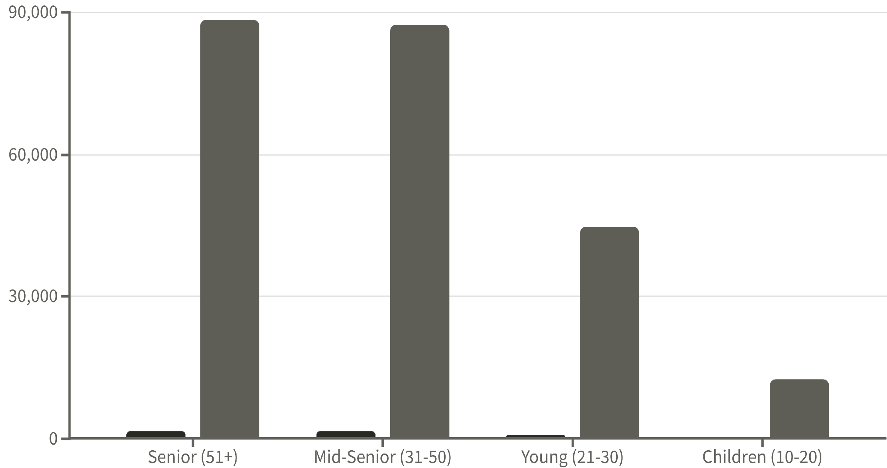
Customer Demographics & Spending
Total Customers
Total Spending
Senior and Mid-Senior age groups dominate both customer count and total spending, representing our core demographic. These segments contribute over 75% of total revenue, making them critical targets for retention and engagement strategies.

Slide 6

Category Performance Analysis
1
2
Clothing
Accessories
Total Sales: $104,264
Total Sales: $74,200
Customers: 1,737
Customers: 1,240
Avg Rating: 3.72
Avg Rating: 3.77
Largest category by revenue and customer base, representing 45% of total sales.
Second-highest performer with strong customer satisfaction scores.
3
4
Footwear
Outerwear
Total Sales: $36,093
Total Sales: $18,524
Customers: 599
Customers: 324
Avg Rating: 3.79
Avg Rating: 3.75
Highest average rating indicates strong product quality and customer satisfaction.
Smallest category but maintains solid customer satisfaction levels.

Slide 7



Top Performing Products
Highest Rated Items
Discount Leaders
Gloves - 3.86 rating
Sandals - 3.84 rating
Boots - 3.82 rating
50%
Hat - 3.80 rating
Skirt - 3.79 rating
Hat
Highest discount usage rate
49.7%
Sneakers
Second in promotional purchases
49.1%
Coat
Strong discount attraction
These top-rated products should be prominently featured in marketing campaigns. The high discount usage rates suggest price sensitivity in certain categories, requiring careful balance between promotional strategies and margin protection.

Slide 8
Geographic & Shipping Insights
Top Markets
Shipping Preferences
Montana leads with $5,784 in sales, followed by Illinois ($5,617) and California ($5,605). These five states represent key geographic markets for targeted expansion.
Standard shipping shows highest average rating (3.82), while Express and 2-Day options maintain strong performance (3.77). Express shipping users represent high-value customer segment.
High-Value Discount Users
A significant number of customers used discounts but still spent above the average purchase amount of $59.76, demonstrating that promotional strategies can attract value-conscious yet high-spending customers without sacrificing revenue.

Slide 9



Customer Loyalty & Subscriptions
1
New (83)
2
Returning (701)
3
Loyal (3,116)
The customer base shows strong loyalty with 80% classified as loyal customers. However, subscription analysis reveals an opportunity:
Non-Subscribers
Subscribers
Average Spend: $59.87
Average Spend: $59.49
Total Revenue: $170,436
Total Revenue: $62,645
Larger segment driving majority of revenue
Opportunity to convert more customers
While spending patterns are similar, the lower subscriber base represents untapped potential for recurring revenue growth through enhanced subscription benefits and targeted conversion campaigns.

Slide 10





Strategic Recommendations
Boost Subscription Programs
Promote exclusive benefits and perks to convert non-subscribers. Focus on demonstrating value through early access, special discounts, and loyalty rewards.
Enhance Customer Loyalty
Implement reward programs for repeat purchases to move customers from returning to loyal segments, capitalizing on the strong existing loyalty base.
Optimize Discount Strategy
Balance promotional sales boosts with margin control. Target discounts strategically to high-value customers while protecting profitability.
Highlight Top Products
Feature highest-rated and best-selling items prominently in marketing campaigns, particularly Gloves, Sandals, and Boots.
Targeted Marketing Focus
Concentrate efforts on high-revenue Senior and Mid-Senior age groups, express-shipping users, and top geographic markets like Montana and Illinois.

